Slide 1
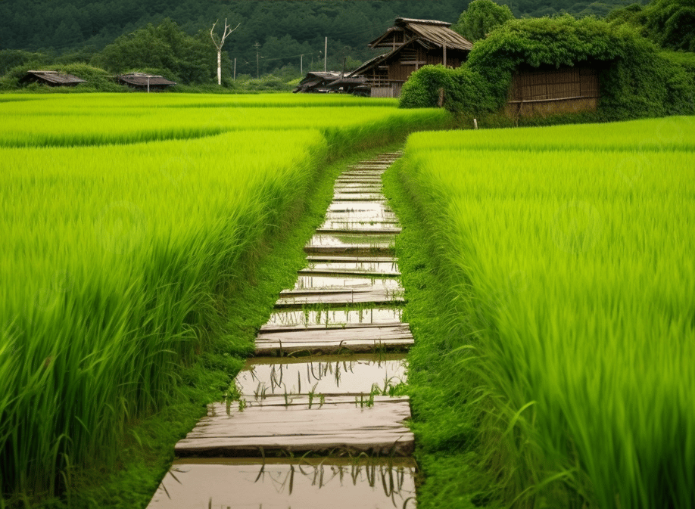
Crop Recommendation
System Using Machine Learning
AIML 7

Slide 2
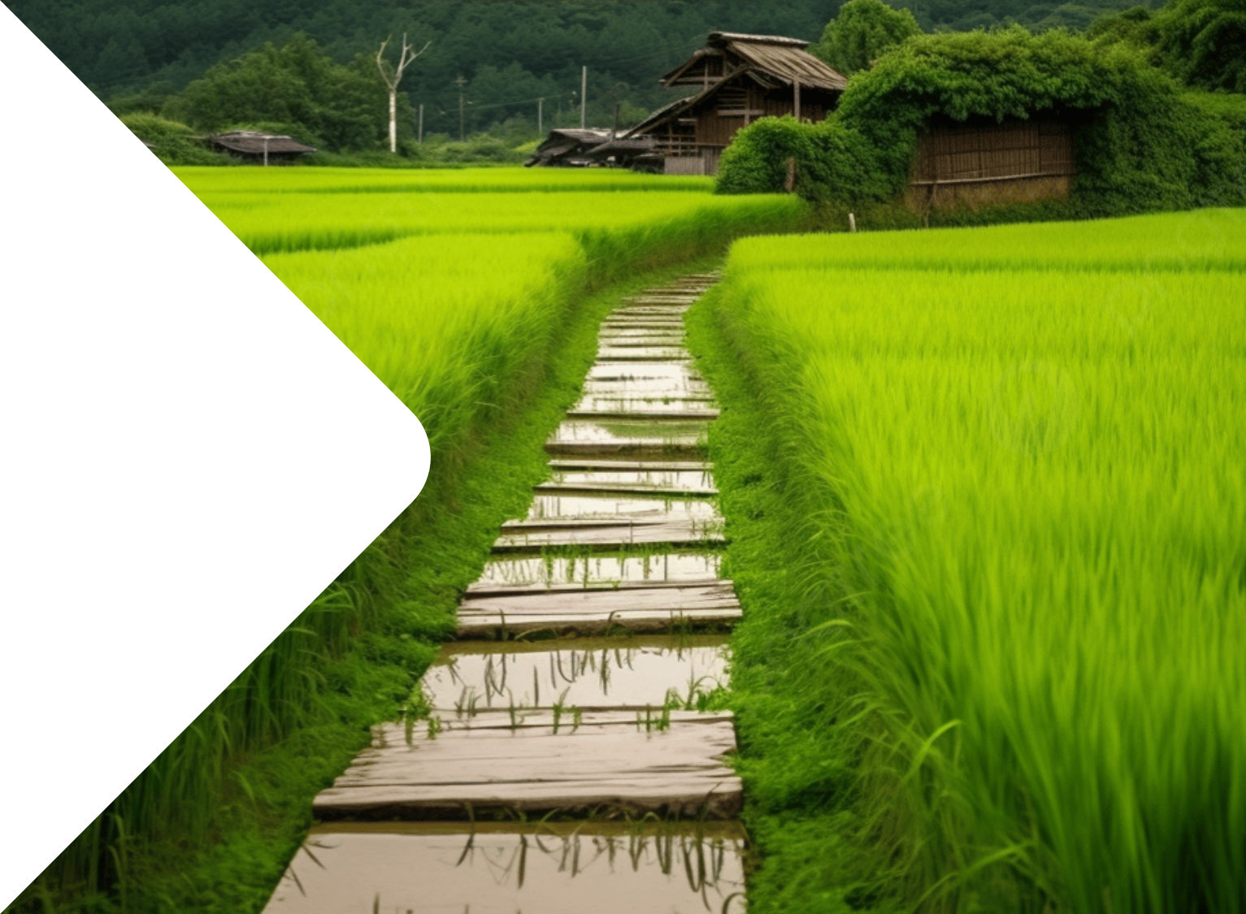
Team Members
Name – ANUSHA PATNAIK
Roll - 21CSEAIML016
Name – GUDLA AMAR
Roll - 21CSEAIML062
Name –SAILADA MUKHUL
Roll - 21CSEAIML037
Team - AIML 7

Slide 3
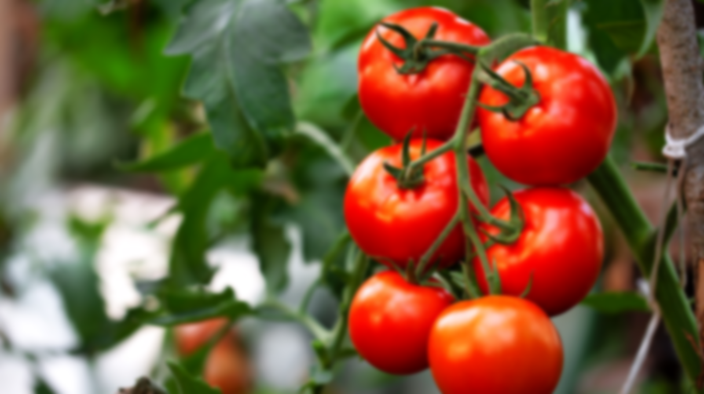
OUTLINE:
Introduction
Aim and Objectives
Algorithms Used
Dataset Discription
Workdone on related area or methodology

Slide 4
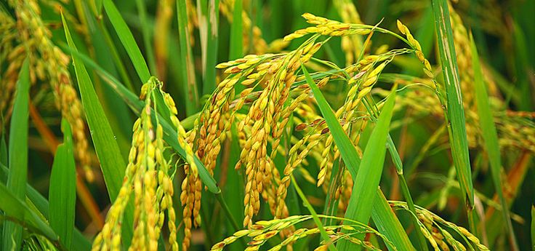
Introduction
India being 3rd largest area in Asia has largest population. It is the leading producer of agriculture products.
Agriculture is the main occupation of Indian people. Agriculture has a sound tone in this competitive world. Many areas Farming acts as major source of occupation.
Agriculture makes a dramatic impact in the economy of a country. Due to the change of natural factors, Agriculture farming is degrading now-a-days.
Agriculture directly depends on the environmental factors such as sunlight, humidity, soil type, rainfall, Maximum and Minimum Temperature, climate, fertilizers, pesticides etc. Knowledge of proper harvesting of crops is in need to bloom in Agriculture.

Slide 5
Existing System
Farmers have words-of-mouth in past decades but now it cannot be used due to climatic factors.
Due to the diversity of season and rainfall, assessment of suitable crops to cultivate is necessary. Farmers face major problems such as crop management, expected crop yield and productive yield from the crops.
Farmers need proper assistant regarding crop cultivation as now-a-days many fresh youngsters are Interested in agriculture.

Slide 6
Disadvantage of Existing System
Prediction of crops was done according to farmer's experience in the past years. Although farmer's knowledge sustains, agricultural factors has been changed to astonishing level.
Due to the diversity of season and rainfall, assessment of suitable crops to cultivate is necessary. Farmers face major problems such as crop management, expected crop yield and productive yield from the crops.
Farmers or cultivators need proper assistant regarding crop cultivation as now-a-days many fresh youngsters are interested in agriculture.
Data is increasing day by day in field of agriculture. With the advancement in Internet of Things, there are ways to grasp huge data in field of Agriculture.

Slide 7
Proposed System
Proposed systems have lent its hands to users to choose items they like. Proposed system is the approach to provide the suggestions to the users of their interest. This can be practiced for agricultural use too.
Based upon the factors of agriculture, farmers are given with ideas for their cultivation process. New techniques to increase crop cultivation can also be recommended
Datasets are collected from Kaggle. Proposed method provides better quality.

Slide 8
Advantages Proposed System
The Proposed system has key role in applying mining, hidden useful knowledge is extracted as well as future predictions can be made. Data gained is classified; Associated and Clustered in aim to make farmers to choose between crops; acquire new farmers and correlate the crops.
Proposed system acts as a good engine to provide suitable items to users considering other factors.
Proposed system assists farmers to choose crops for rotation and proper fertilizers.
Based on the soil analysis report, fertilizers have been recommended to farmers considering Nitrogen, Phosphorus, Potash and Sulphur nutrients.

Slide 9
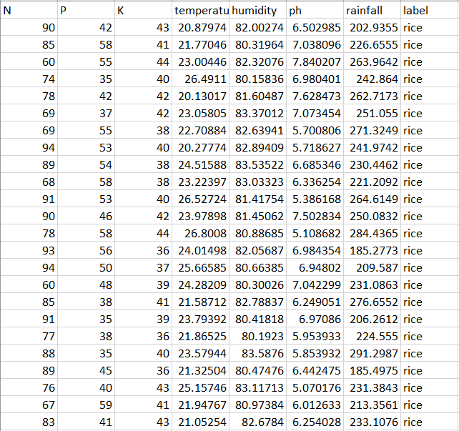
Data Set Description
Total rows 2200
Total attributes 8
Attribute names Nitrogen , potassium , sodium, Temperature, humidity, ph , label , Rainfall
Total data taken for training 1760 for testing 440

Slide 10
Work done on the related area
Input Dataset
In this step dataset is inserted which was collected from kaggle
Pre processing
In this step cleaning of dataset is done by replacing null values , changing all datatype to int , etc are done
Training
Using Different Algorithms our model is trained here , we have used, Decision Tree , Random forest, , etc
Prediction
Prediction of all algorithms are compared and one with maximum accuracy is chosen .
Deployment and application
Web app is made using flask which will show output and the model in which we have got maximum accuracy is deployed

Slide 11
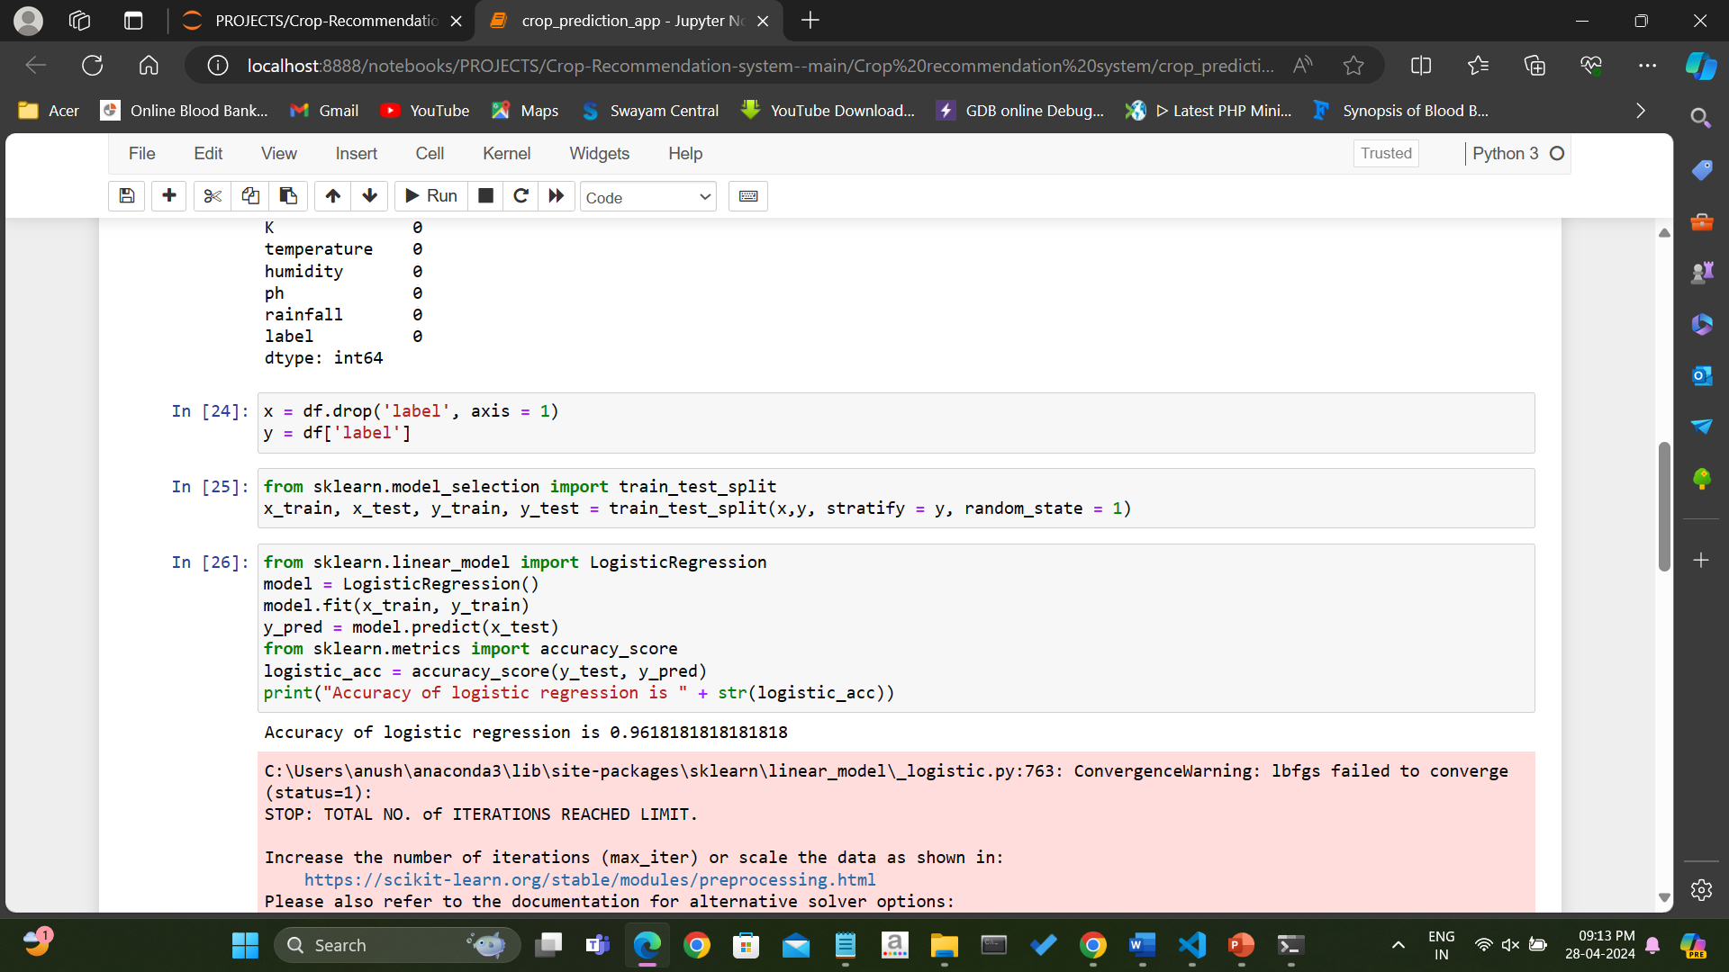
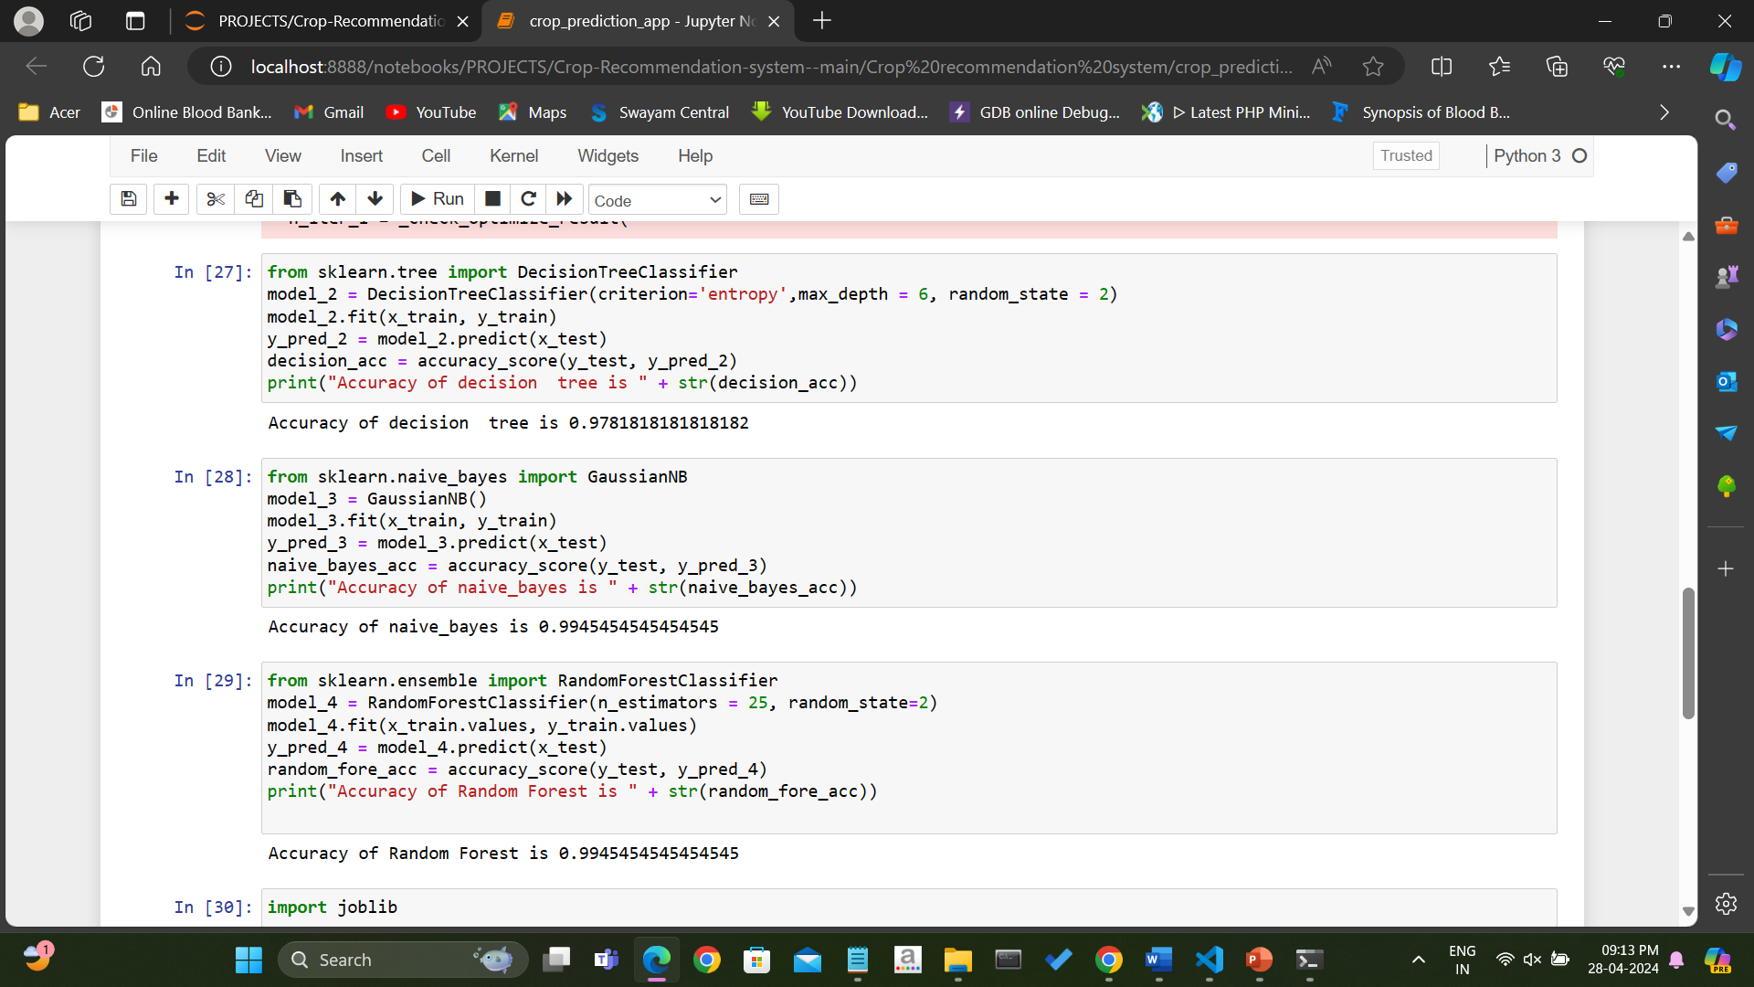
Algorithms used Accuracy
Logistic Regression
Naive Bayes
Decision Tree
Random Forest

Slide 12
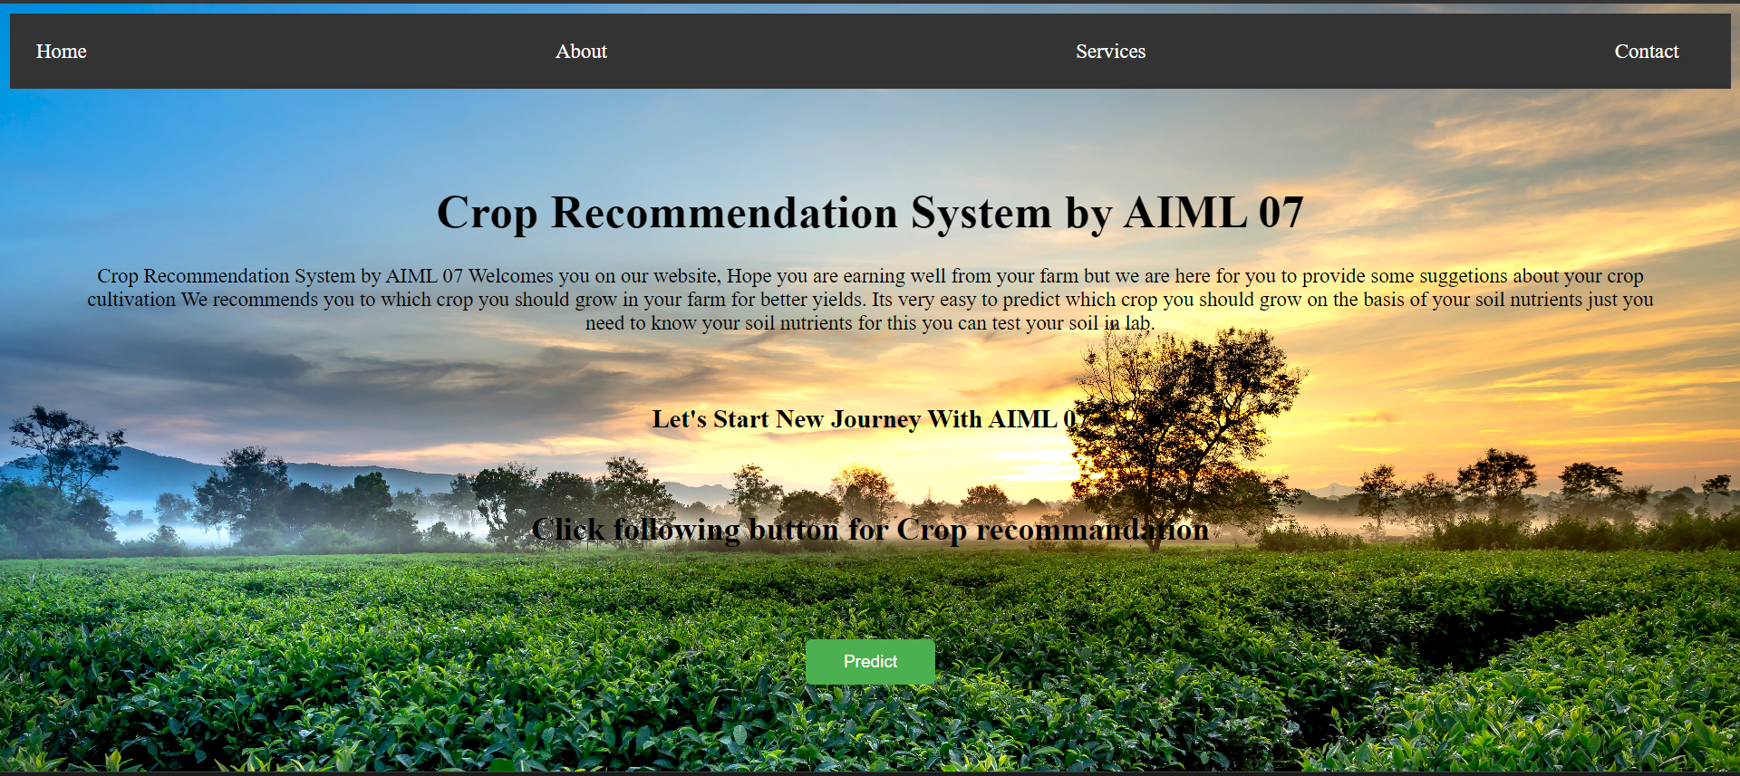
OUTPUTS

Slide 13
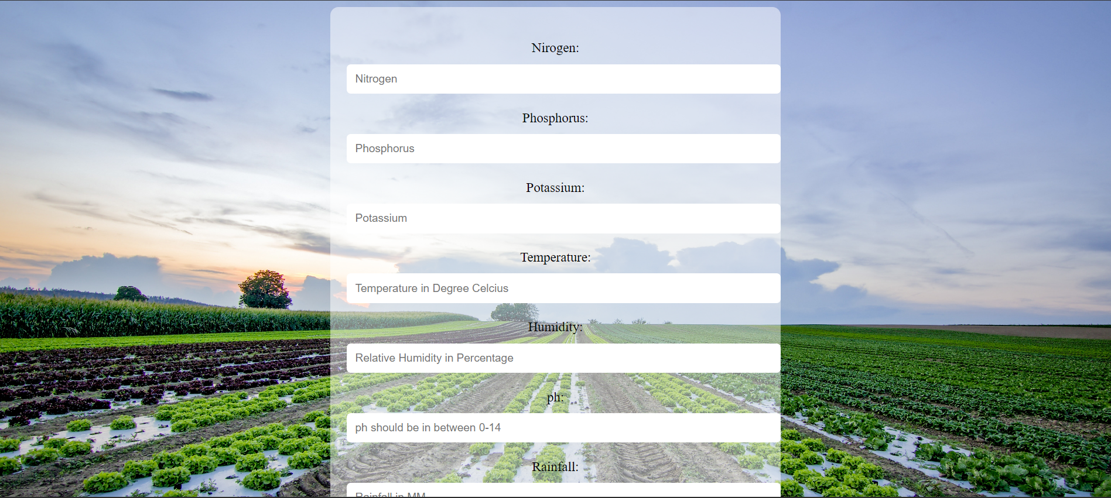

Slide 14
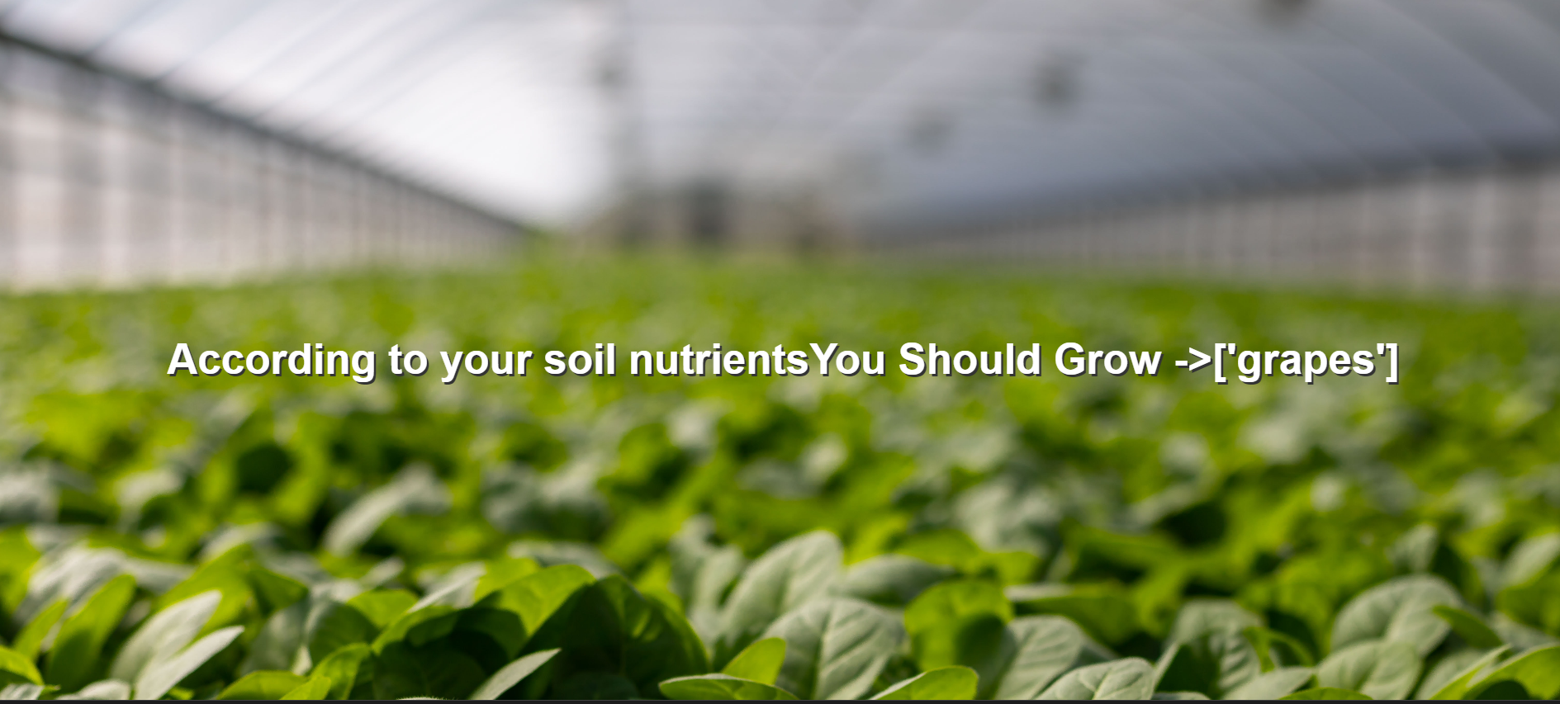

Slide 15


